Slide 1
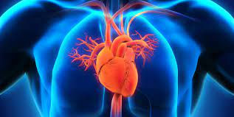

Exploratory Data Analysis To Predict The Disease
Project Members
Muhammad Haseeb Ishaq 2021389
Muhammad Ramiz Saud 2021435
Muhammad Babar Ayyaz 2021362

Slide 2


Introduction & Problem Statement
Heart strokes are a significant public health concern, with a high prevalence and severe health consequences.
Early detection followed by prevention helps in reducing the risk.
Performed EDA for this disease prediction at early stages.

Slide 3
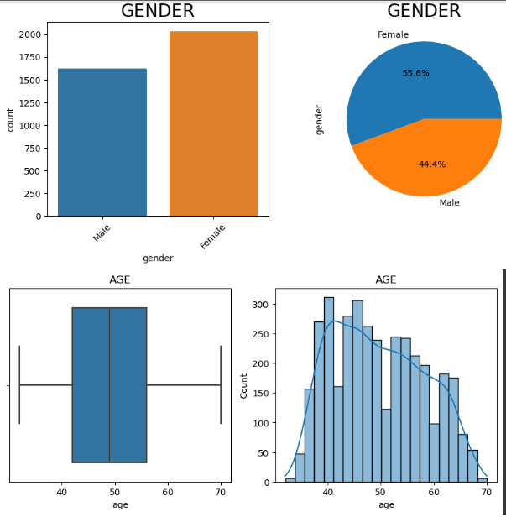
Methodology
Used Pandas, Matplotlib, Seaborn, Numpy and Math libraries.
Preprocessing of data.
Visualized each feature/ column of dataset.
Box plot, Bar chart, Histogram , Pie chart etc.
Found the correlation between different columns of dataset.
Mapping results on heat map.
Inferring the results.

Slide 4
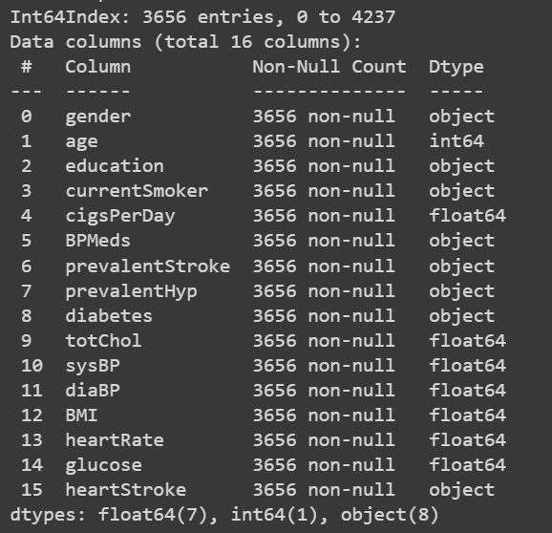
Brief details of dataset
"heart_disease.csv"
Famous dataset of 1988.
Dataset contains both, discrete and continuous values.
Contains 16 columns and 3656 row entries.

Slide 5
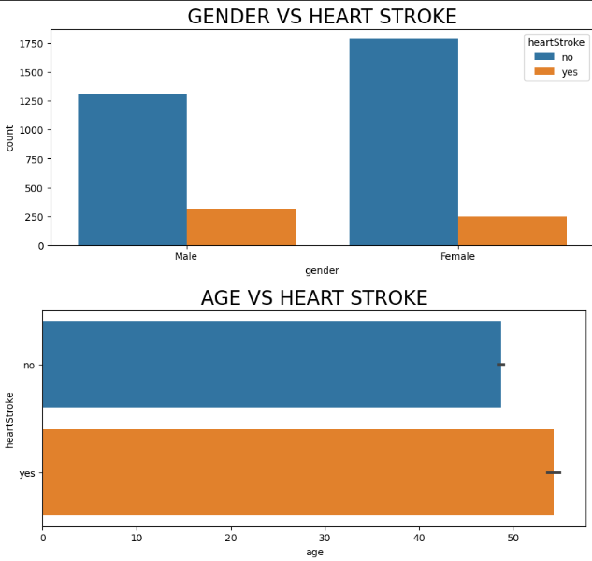
Results & Discussion (Significance)
With the help of several facts and figures, desired goal is achieved.
Some most significant assumptions could be seen by graphical output.
More number of males experience heart stroke as compared to females.
Similarly, the greater the age of the person, more are the chances of him to experience the heart stroke.

Slide 6
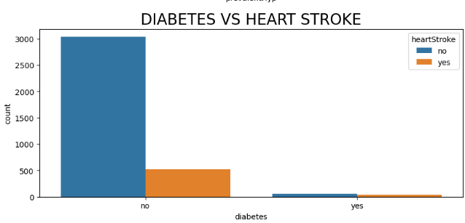
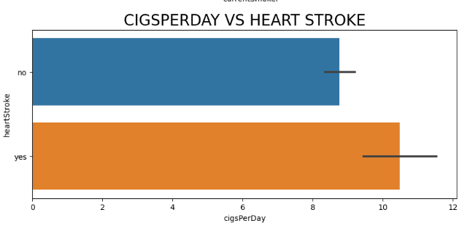
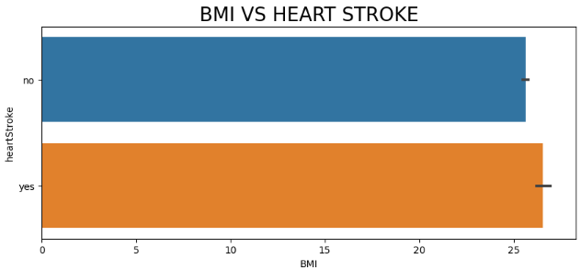
RESULTS & DISCUSSION (SIGNIFICANCE) cont'd...
Greater the BMI of a person, more are his chances to get this disease.
According to our dataset, the persons without diabetes have more chances to catch this illness than those who are diabetic.
The number of cigarettes smoked in a day also impacts the probability of catching the disease in a manner of positive correlation.

Slide 7

References
Dataset: https://www.kaggle.com/datasets/mirzahasnine/heart-disease-dataset?datasetId=2990194&sortBy=voteCount
Pandas: https://pypi.org/project/pandas/
Numpy: https://pypi.org/project/numpy/
Matplotlib: https://pypi.org/project/matplotlib/
Seaborn: https://pypi.org/project/seaborn/

Slide 8
Thank you!

